Slide 1
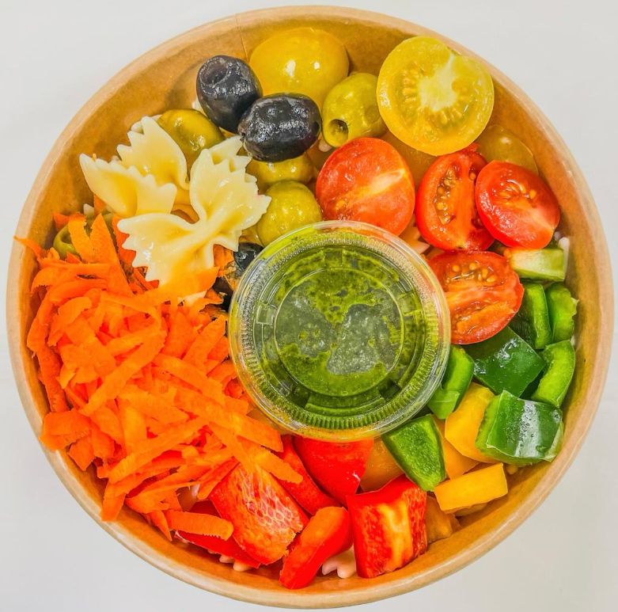
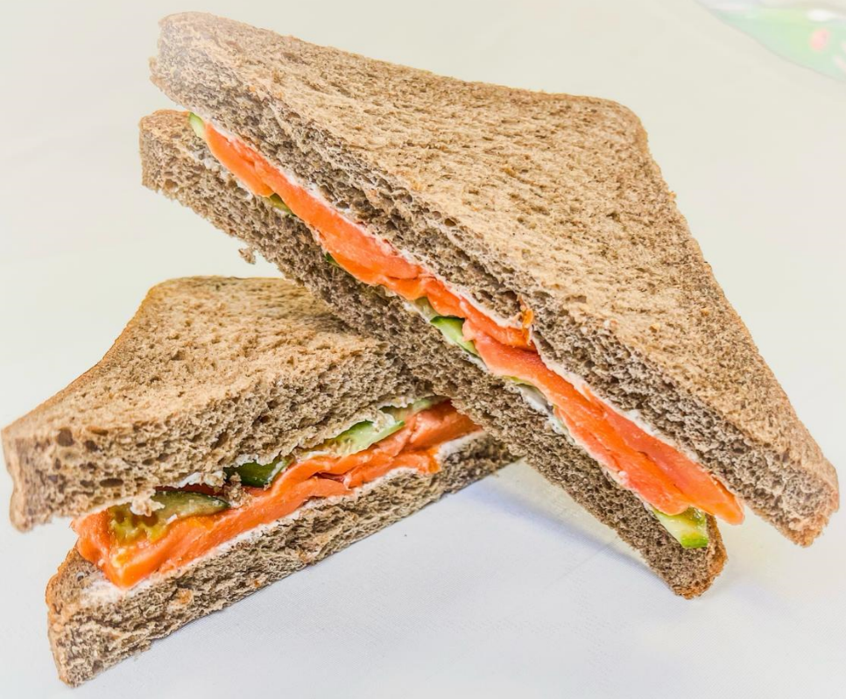
Term 3 & April Subscriptions are now OPEN!
Termly Plan
Monthly Plan
Daily Meal
Voucher Booklet
Grab n’ Go
The school canteen is cashless
Please scan the QR code or click here to download the app
For the step-by-step guide on how to use the application, please follow the detailed description available here
Student canteen ID: Required daily for meals & Grab n’ Go
Family Balance: Share a family account, one recharge for all children. You can set limits in the child’s settings.
Absence & Cancellations: for reimbursement, 48 hours notice is required and will be credited to the family account.
Cancellation: Email canteen-ec@swisscanonica.ae , 15 days notice for Monthly/Term
Term 3 Plan
(Monday to Thursday)
FS: 1049 AED
Y1 – Y6: 1136 AED
Y7 – Y13: 1224 AED
April Monthly Plan
(Monday to Thursday)
Subscriptions: Open 8th to 25th monthly
Late Purchases: Daily Meal Prices, no extra bundle discounts
FS: 240 AED
Y1 – Y6: 260 AED
Y7 – Y13: 280 AED
For more detailed information visit:
englishcollegedubai.com/info-hub/canteen

